Slide 1
Group 4

Slide 2
Generalization(泛化)
Haohui Wu

Slide 3
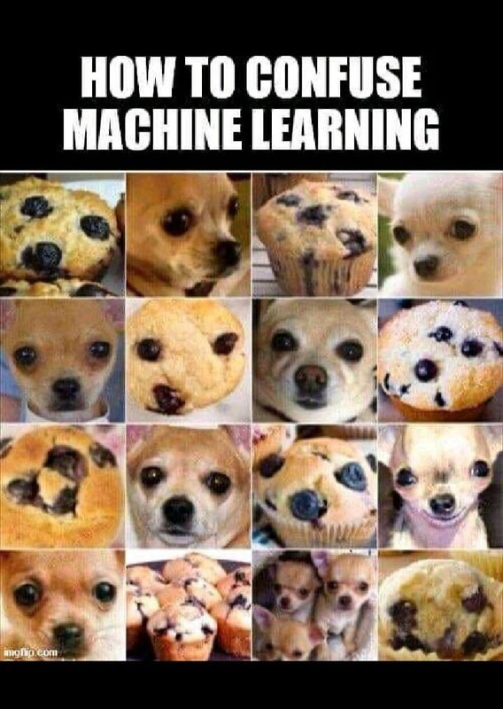
What?
Model’s capability to apply training data to unseen situation, and ability to abstract information.
Humans are good at generalization.
Muffin or Chihuahua?

Slide 4
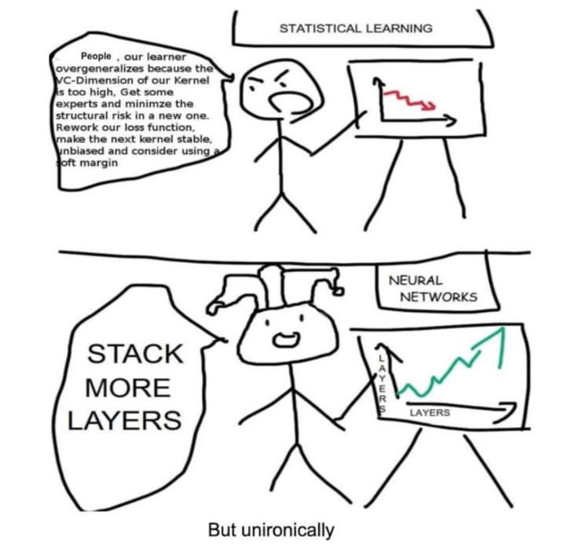
How? - Transformer-based model & Large scale
Process all inputs simultaneously (Parallelization), Attention mechanism
Pre-trained on diverse range of internet text through unsupervised learning
Large scale of parameters/weights (GPT-3 175 billion, GPT-4 1.5 trillion)

Slide 5
How? - Fine-tuning
Train on well-generated narrower dataset to adapt its board knowledge to more specific tasks or domains
Refine output and Improve relevance
Generalize better in the context it will be used

Slide 6
Emergent–涌现
Jiacong Wu

Slide 7
Definition
According to Emergent Abilities of Large Language Models: (https://arxiv.org/abs/2206.07682v2 )
Emergence is when quantitative changes in a system result in qualitative changes in behavior.
An ability is emergent if it is not present in smaller models but is present in larger models.

Slide 8
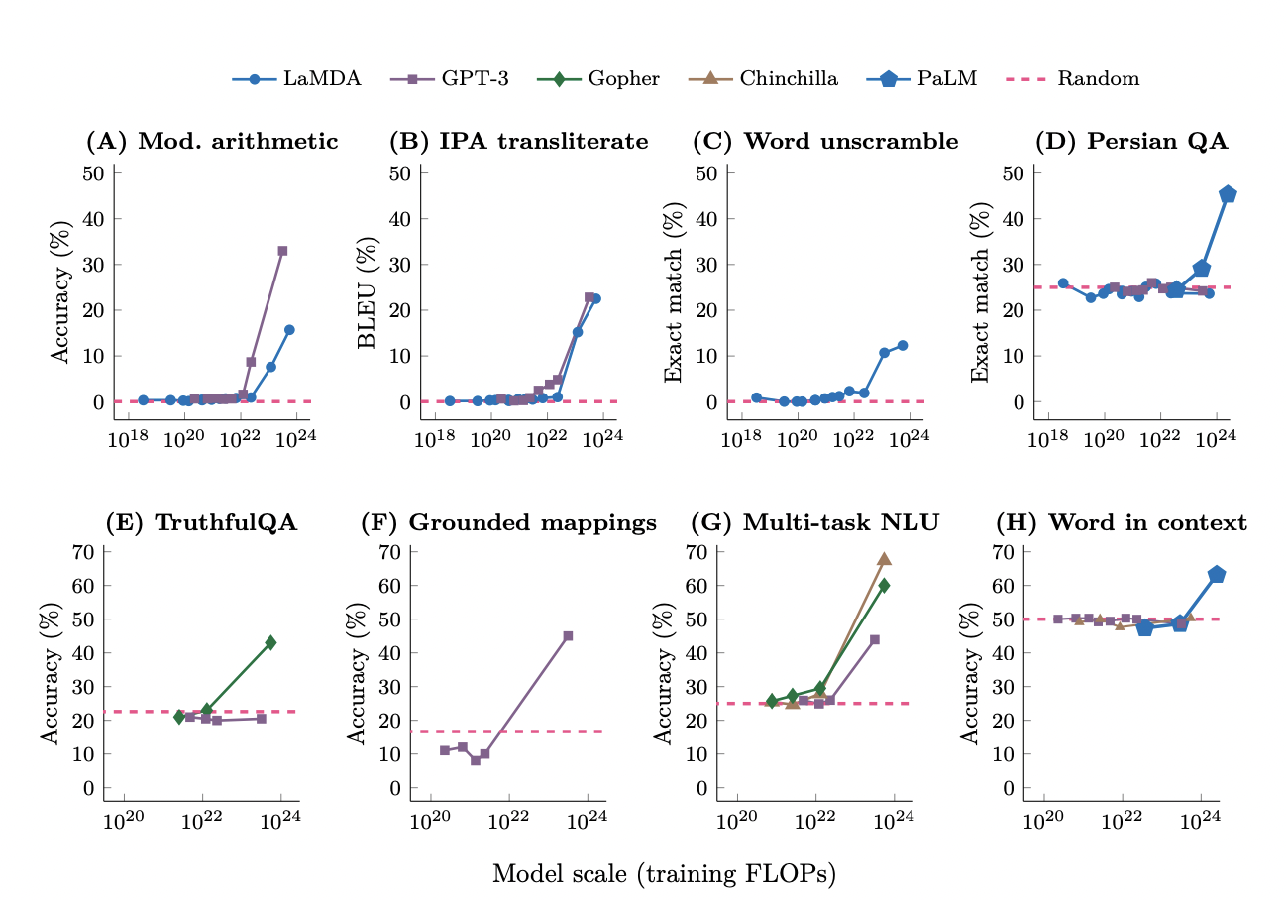
Few-shot prompting
BIG-Bench
TruthfulQA
Grounded conceptual mappings
Multi-task language understanding
Word in Context
From Emergent Abilities of Large Language Models, 2022

Slide 9
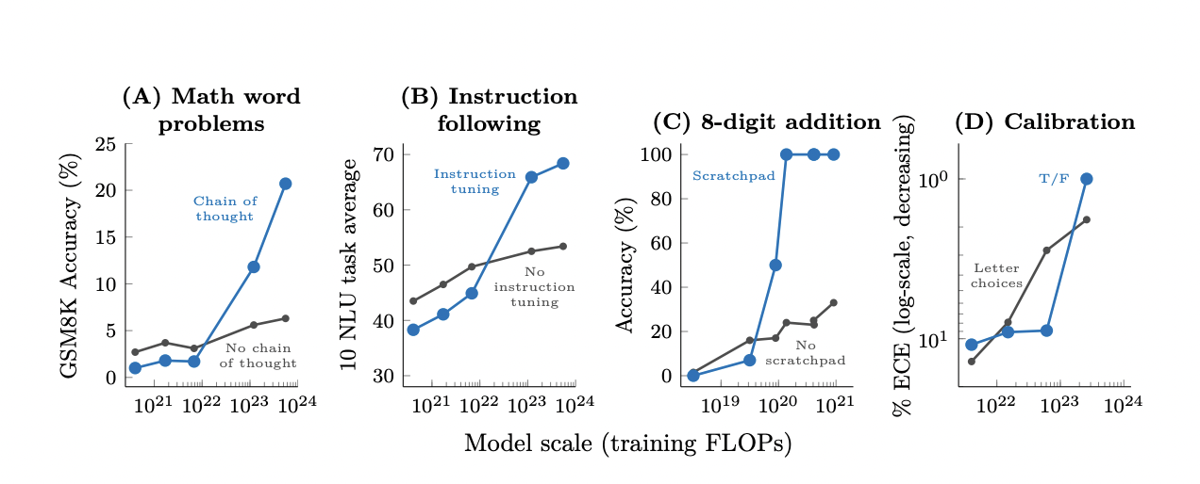
Abilities of Emergent
Chain-of-thought prompting
Instruction following
Program execution
Model calibration

Slide 10
Disagreement
“We provide evidence that alleged emergent abilities evaporate with different metrics or with better statistics, and may not be a fundamental property of scaling AI models.”
– Schaeffer et al., Are Emergent Abilities of Large Language Models a Mirage?

Slide 11
(AI) alignment
Xin Tan (Carol)

Slide 12
Definition
Ensure that artificial intelligence systems can achieve our outcomes as we desire and act in human’s interest (Safety of AI)

Slide 13
Example: Open AI Alignment approaches
Use human feedback
Reinforcement learning
InstructGPT (less cost, less creative than pretrained)
Assist human evaluation
recursive reward modeling (RRM), debate, iterated amplifications
Do alignment research
Generating → Evaluating

Slide 14
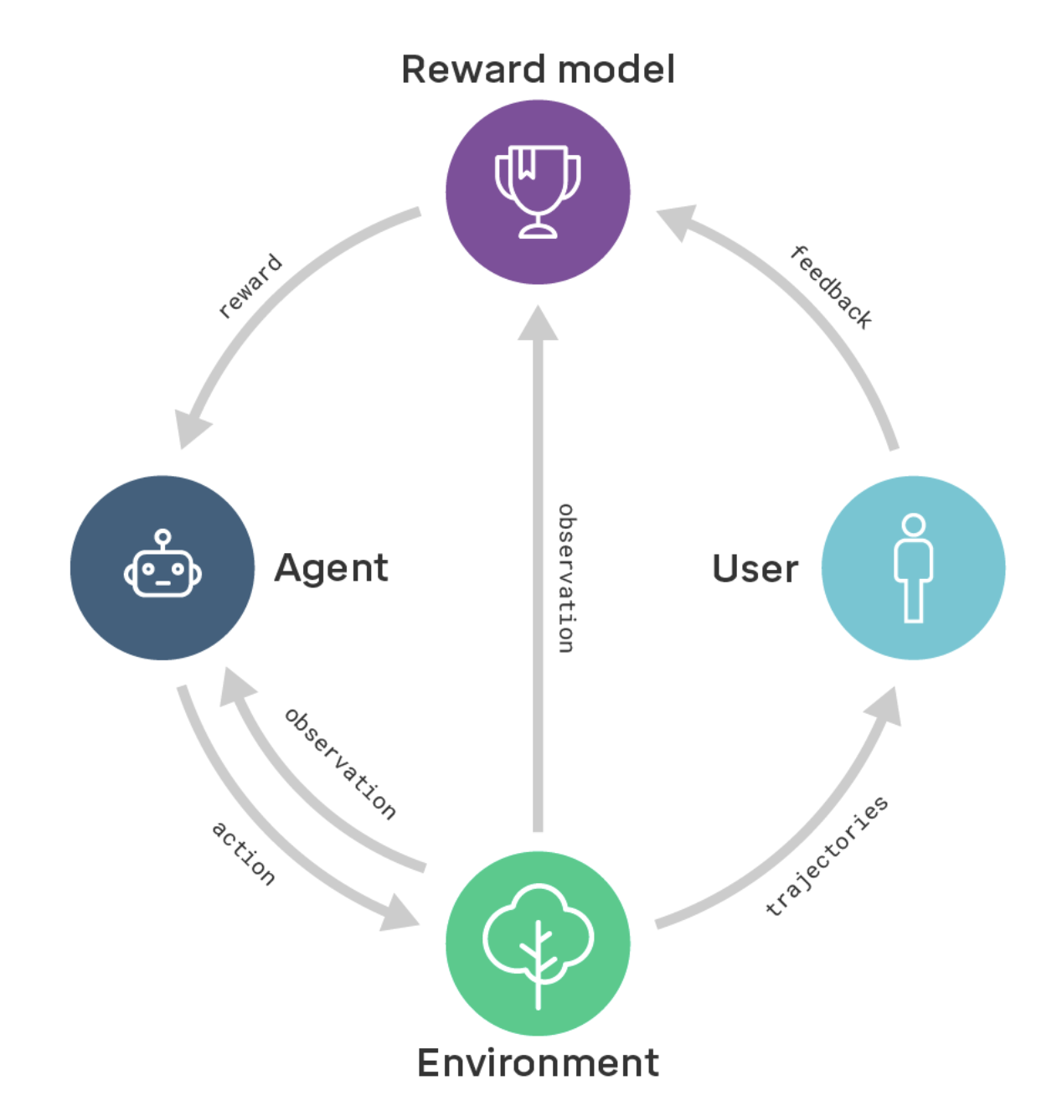
Reward model and reinforcement learning

Slide 15
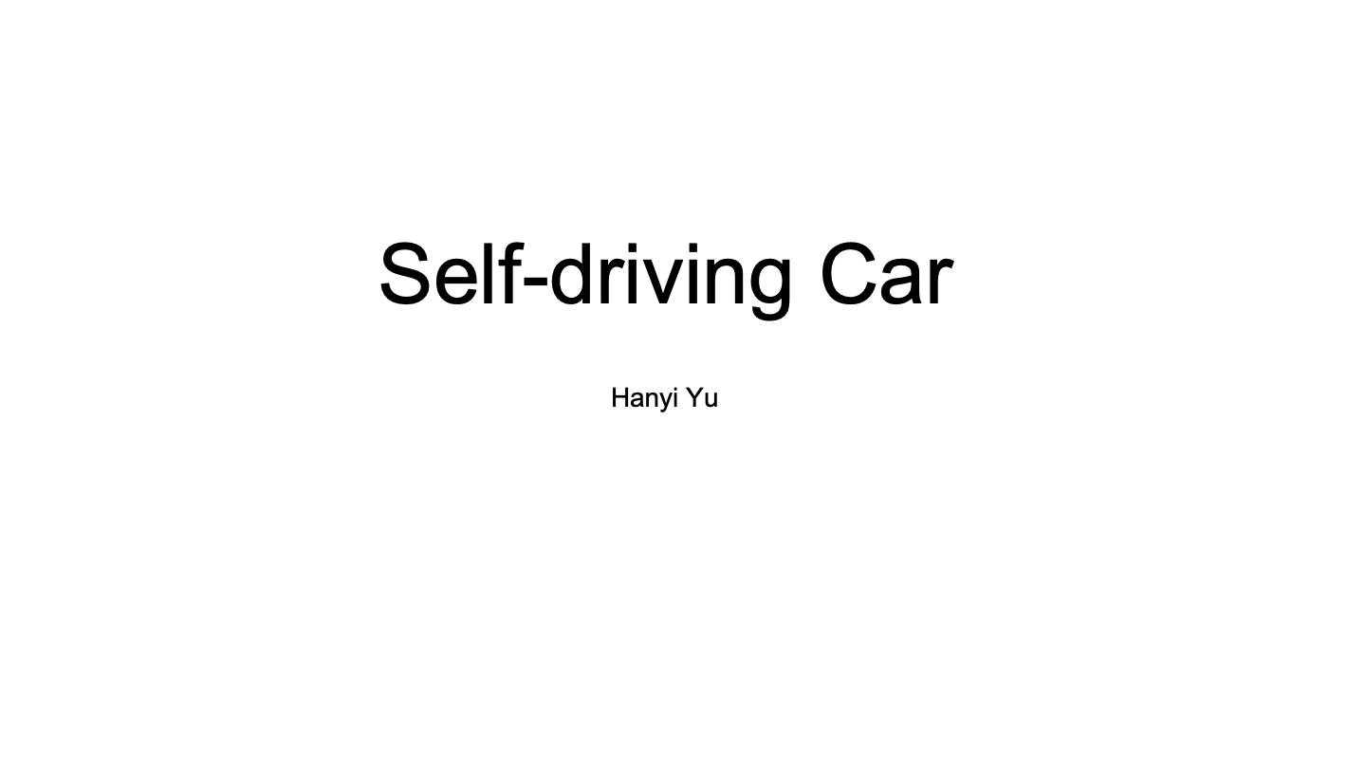

Slide 16
Five essential component:
Computer Vision:
Understand the surrounding environment
Sensor fusion:
Integrating data from various sensors
Localization:
Determining the vehicle's position
Path planning:
Plan how to reach the desired destination
Control:
Enable the vehicle to execute the planned trajectory

